Slide 1
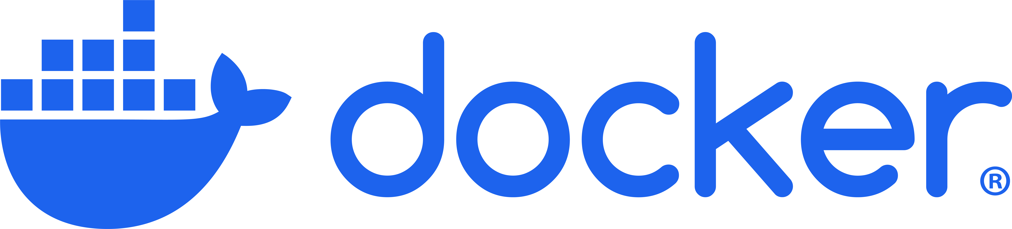

Part 2: Docker File Intro

Slide 2
What We Will Cover
Creating a Docker File
Using a Docker File
Running the Container

Slide 3
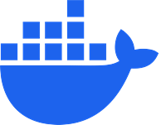
Creating a Docker File

Slide 4
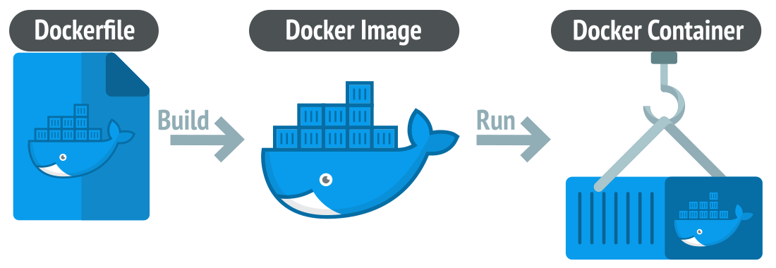
Notes:
https://www.linkedin.com/pulse/what-docker-how-create-image-execute-application-within-varun-lobo

Slide 5
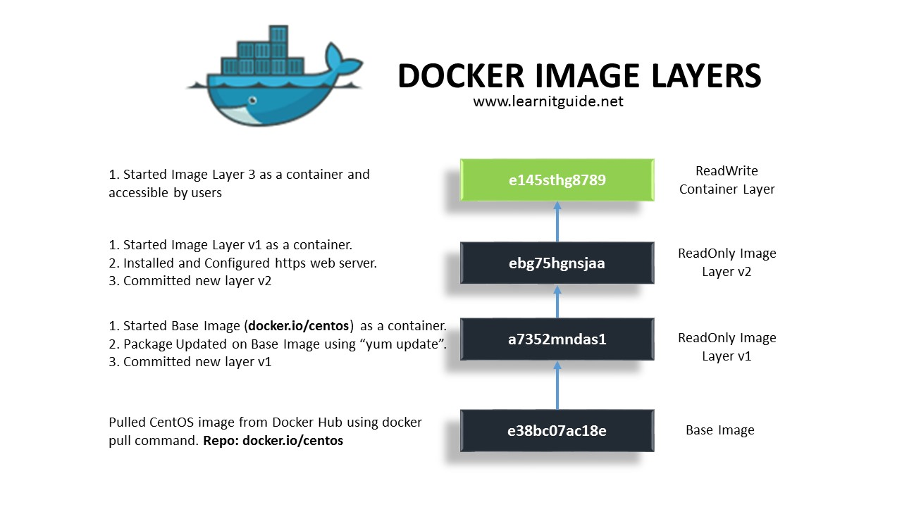
Notes:
https://pikanpie.wordpress.com/2019/03/16/docker-image/

Slide 6
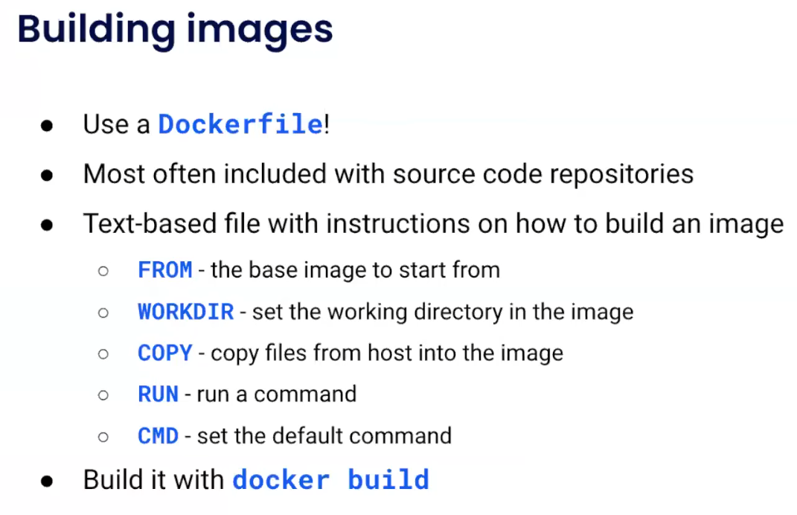
Notes:
https://www.youtube.com/watch?v=t2aKpgYErsk

Slide 7
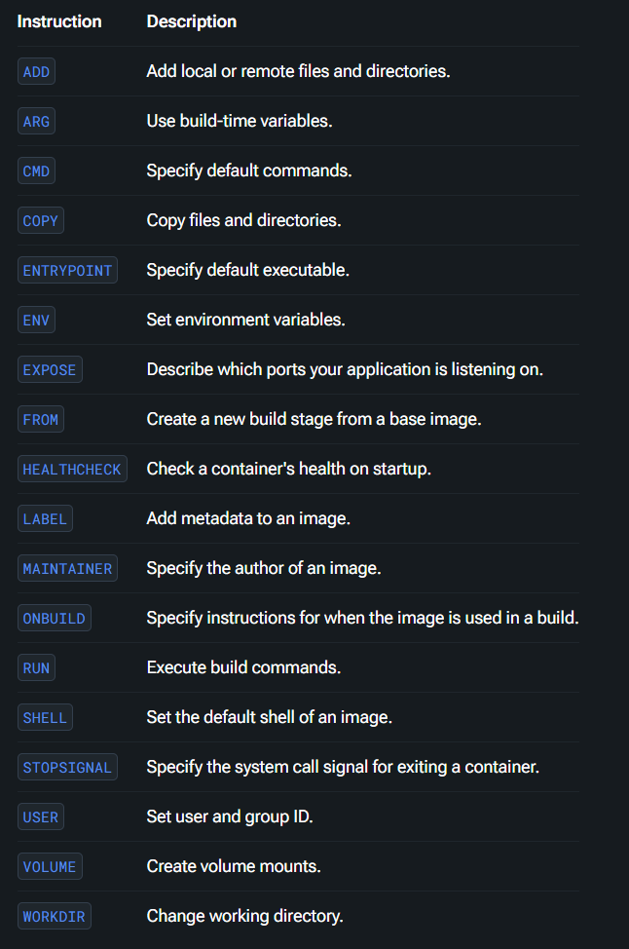
There are a Lot More Commands
Notes:
https://docs.docker.com/reference/dockerfile/#overview

Slide 8
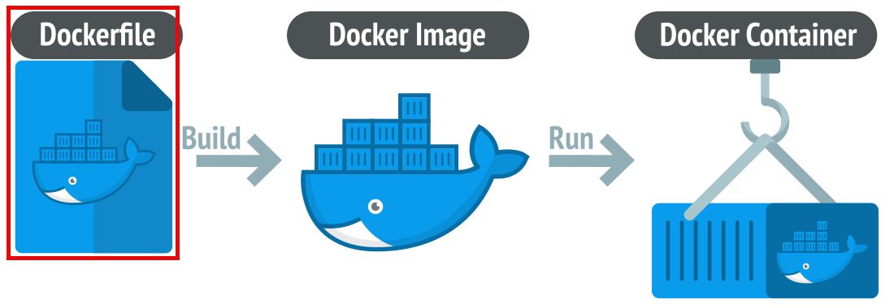
Notes:
https://www.linkedin.com/pulse/what-docker-how-create-image-execute-application-within-varun-lobo

Slide 9
Demo: Creating a Docker File
# Use the official Python image
FROM python:3
# Set the working directory
WORKDIR /usr/src/app
# Copy the requirements file
COPY requirements.txt ./
# Install dependencies
RUN pip install --no-cache-dir -r requirements.txt
# Copy the rest of the application files
COPY . .
# Create an output directory for results
RUN mkdir -p /usr/src/app/output
# Start with bash shell to allow interactive use
CMD ["/bin/bash"]
Notes:
# Use the official Python image
FROM python:3
# Set the working directory
WORKDIR /usr/src/app
# Copy the requirements file
COPY requirements.txt ./
# Install dependencies
RUN pip install --no-cache-dir -r requirements.txt
# Copy the rest of the application files
COPY . .
# Create an output directory for results
RUN mkdir -p /usr/src/app/output
# Start with bash shell to allow interactive use
CMD ["/bin/bash"]

Slide 10



Notes:
https://www.youtube.com/channel/UC35ZpwldGw7ZJ5R-2sLijzw

Slide 11

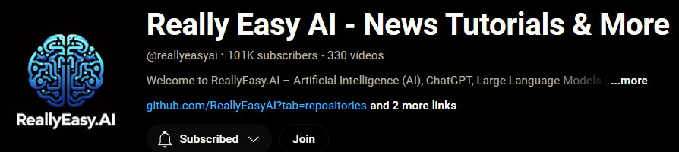
Become a Member!
Notes:
https://www.youtube.com/channel/UC35ZpwldGw7ZJ5R-2sLijzw/join

Slide 12

https://www.youtube.com/@AINewsFresh

Slide 13
Using a Docker File

Slide 14
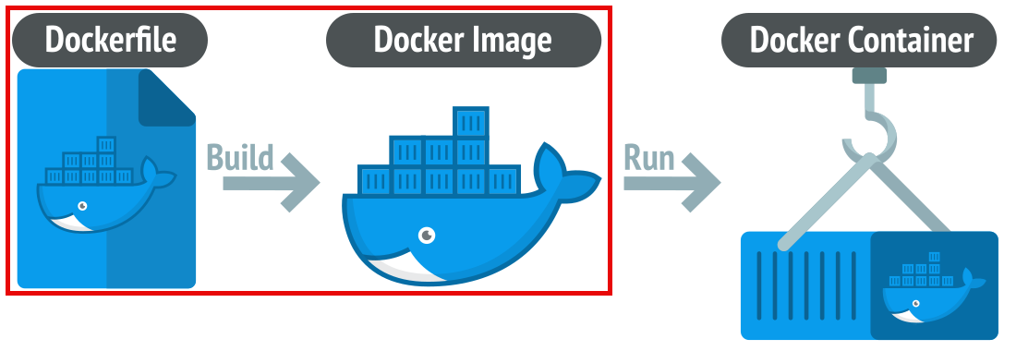
Notes:
https://www.linkedin.com/pulse/what-docker-how-create-image-execute-application-within-varun-lobo

Slide 15
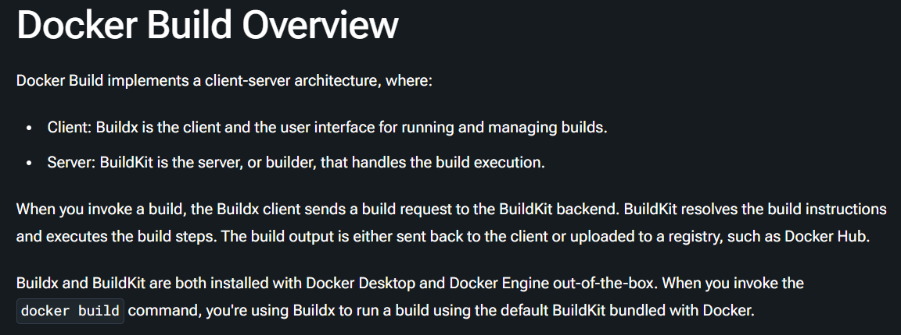
Notes:
https://docs.docker.com/build/concepts/overview/

Slide 16
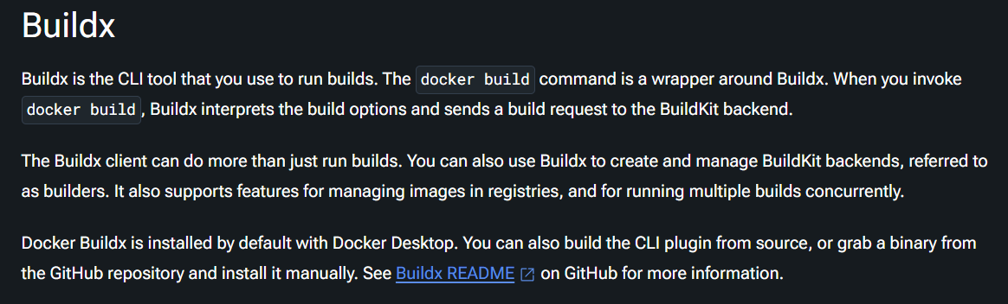
Notes:
https://docs.docker.com/build/concepts/overview/

Slide 17
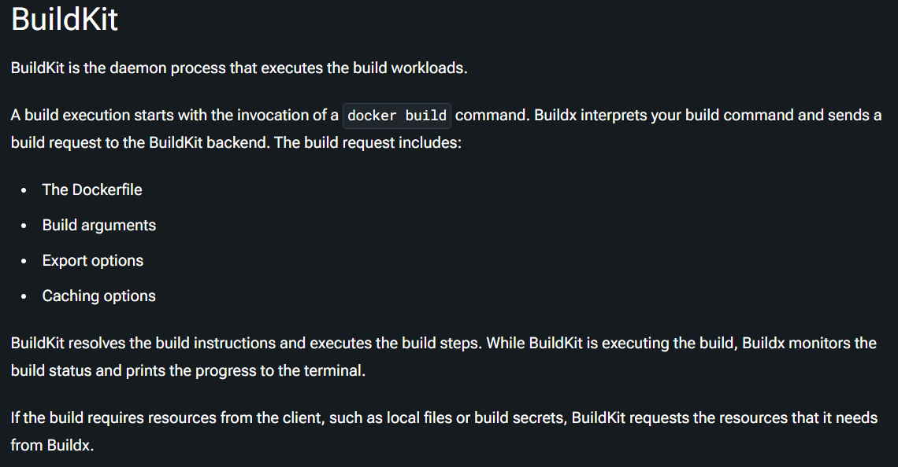
Notes:
https://docs.docker.com/build/concepts/overview/

Slide 18
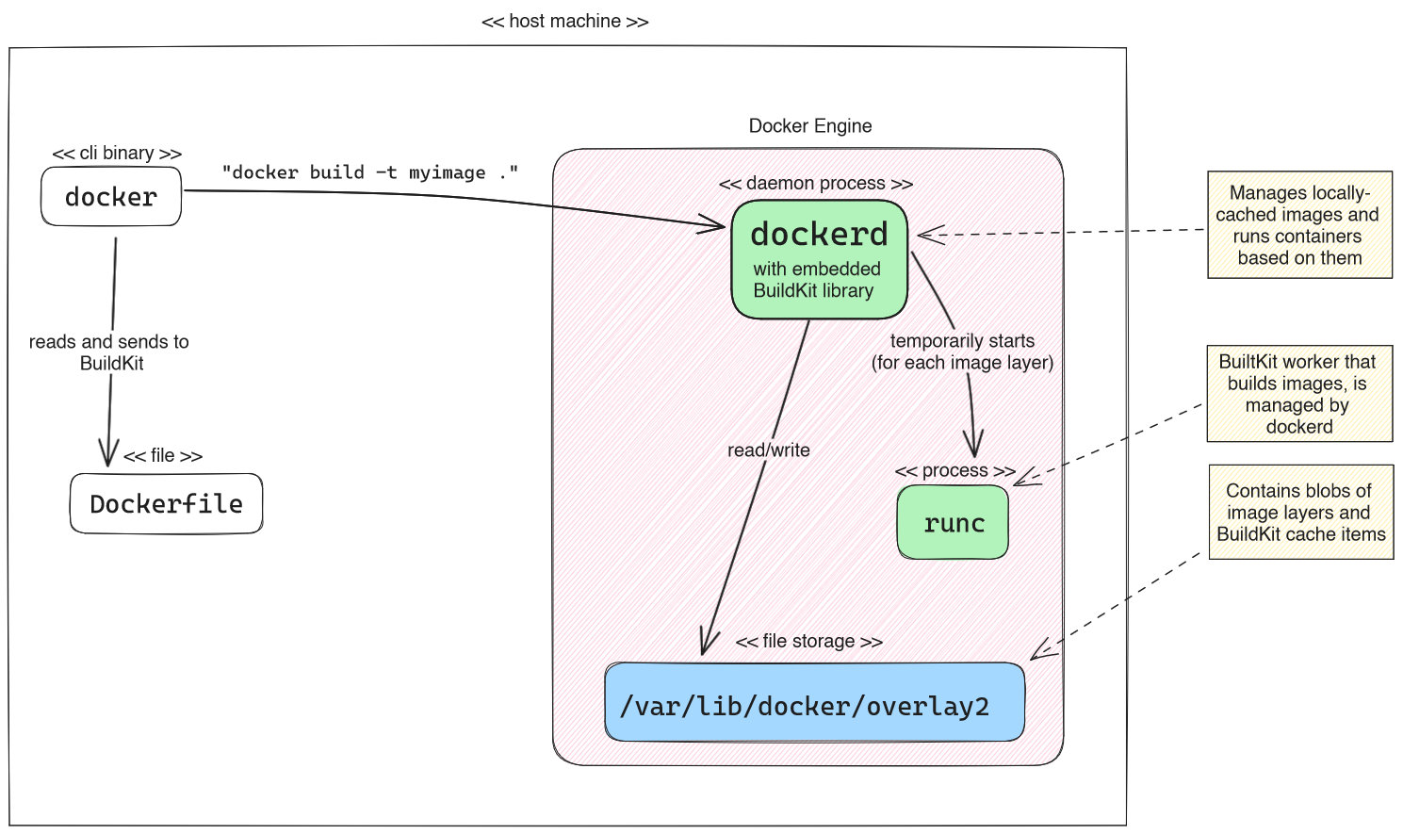
Notes:
https://www.augmentedmind.de/2023/10/29/docker-and-buildkit-3-approaches/

Slide 19
Creating an Image from a Docker File
docker build -t data_science_demo .
Notes:
docker build -t data_science_demo .

Slide 20
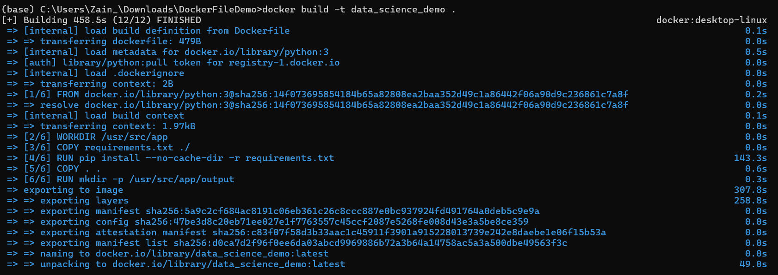
Demo: Creating an Image from a Docker File
Notes:
docker build -t data_science_demo .

Slide 21
Running the Container

Slide 22
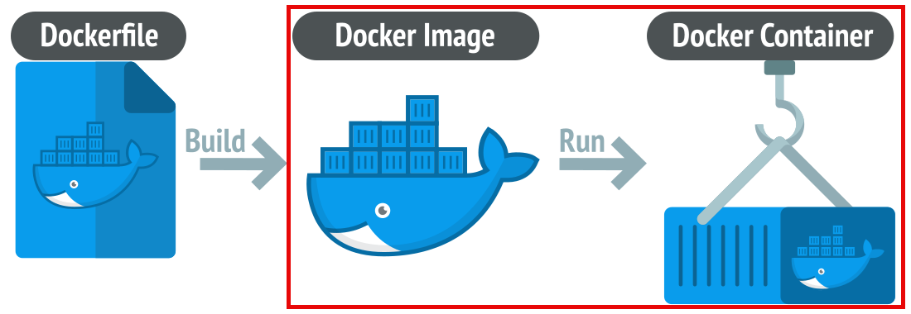

Slide 23
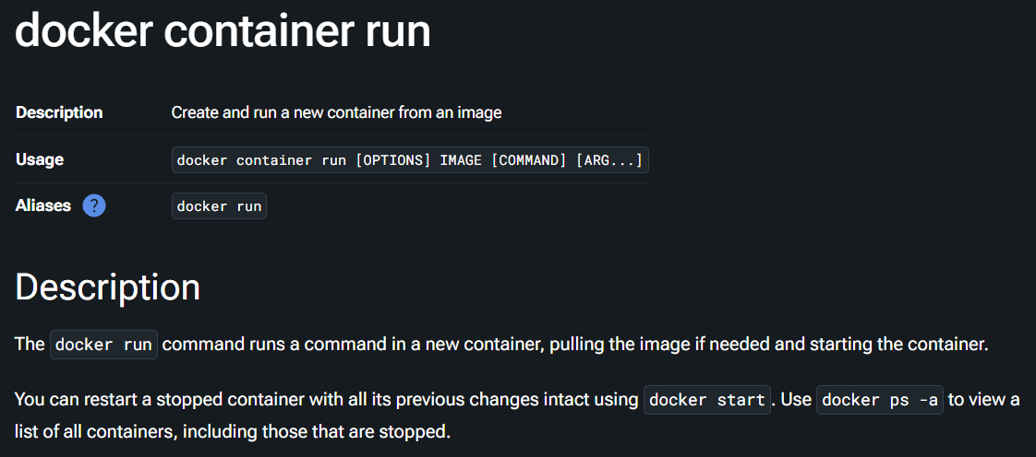
Notes:
https://docs.docker.com/reference/cli/docker/container/run/

Slide 24
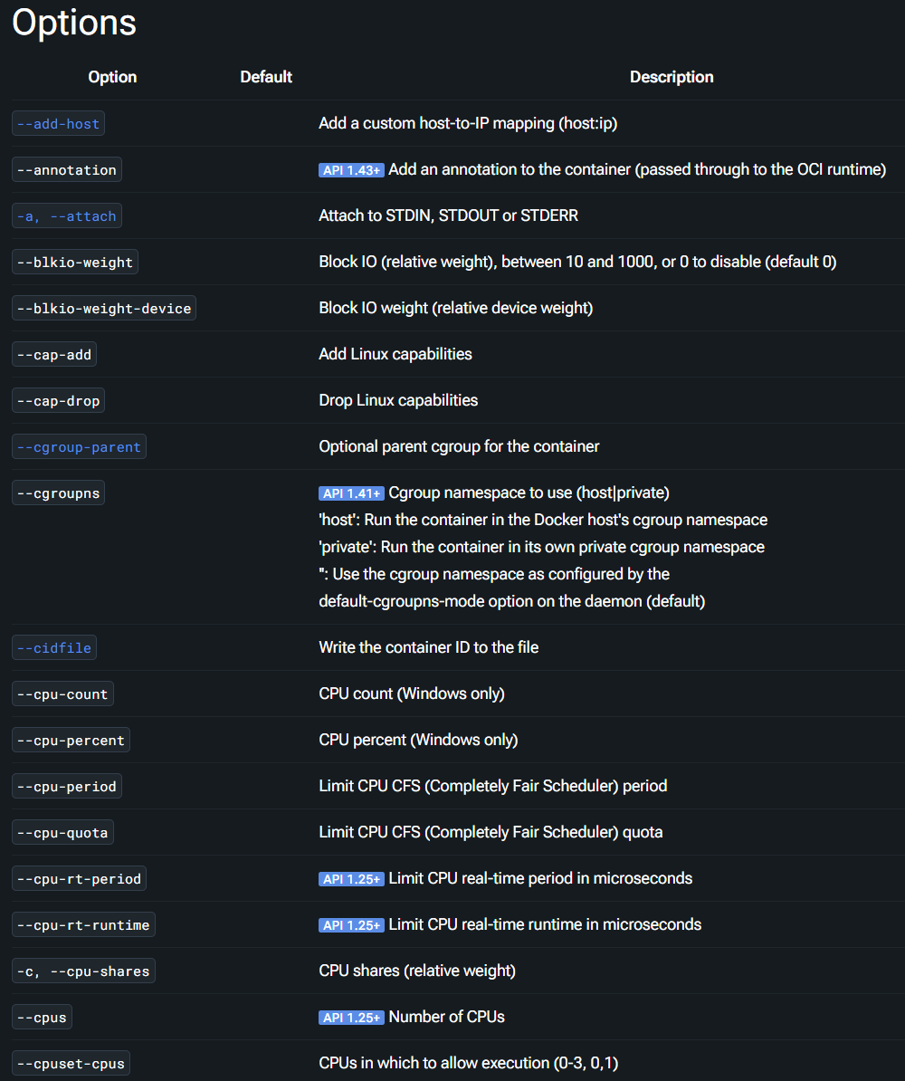
Tons of Options
Notes:
https://docs.docker.com/reference/cli/docker/container/run/

Slide 25
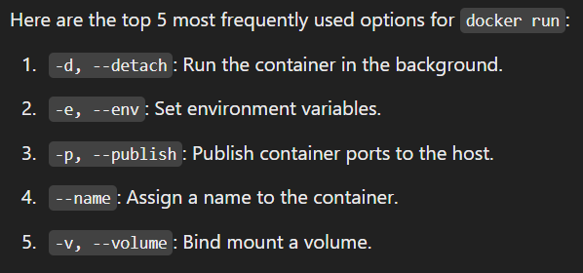
Top 5 Options for Docker Run
Notes:
https://docs.docker.com/reference/cli/docker/container/run/

Slide 26
Demo: Running the Container
docker run -it --name data-science-fun
-v C:/Users/Zain_/Downloads/DockerFileDemo/output:/usr/src/app/output data_science_demo
Notes:
docker run -it --name data-science-fun -v C:/Users/Zain_/Downloads/DockerFileDemo/output:/usr/src/app/output data_science_demo

Slide 27


